Slide 1

Now it’s your turn to put this into practice. Your task is to begin building your own resource map.
1. Use the layout in the provided Powerpoint slide to create your resource map. Start by identifying five resources in your area that you could use to support clients. These might include clinics, food banks, housing services, transportation programs, or community organizations.
2. For each resource, include critical contact information— location, phone number, hours, eligibility criteria, and any key details like languages offered.
3. For your map image, use whichever method is easiest and most practical for you. A screenshot from Google Maps with your selected locations marked or starred is perfectly acceptable for this project.
As you create your map, consider what format will best support your organization and accessibility moving forward in your role as a community health worker.
Because building a strong resource map isn’t just an exercise— it’s a tool you’ll use every day to better support your community.
See the next page for an example.
Service Coordination 2a
The Resource Map

Slide 2
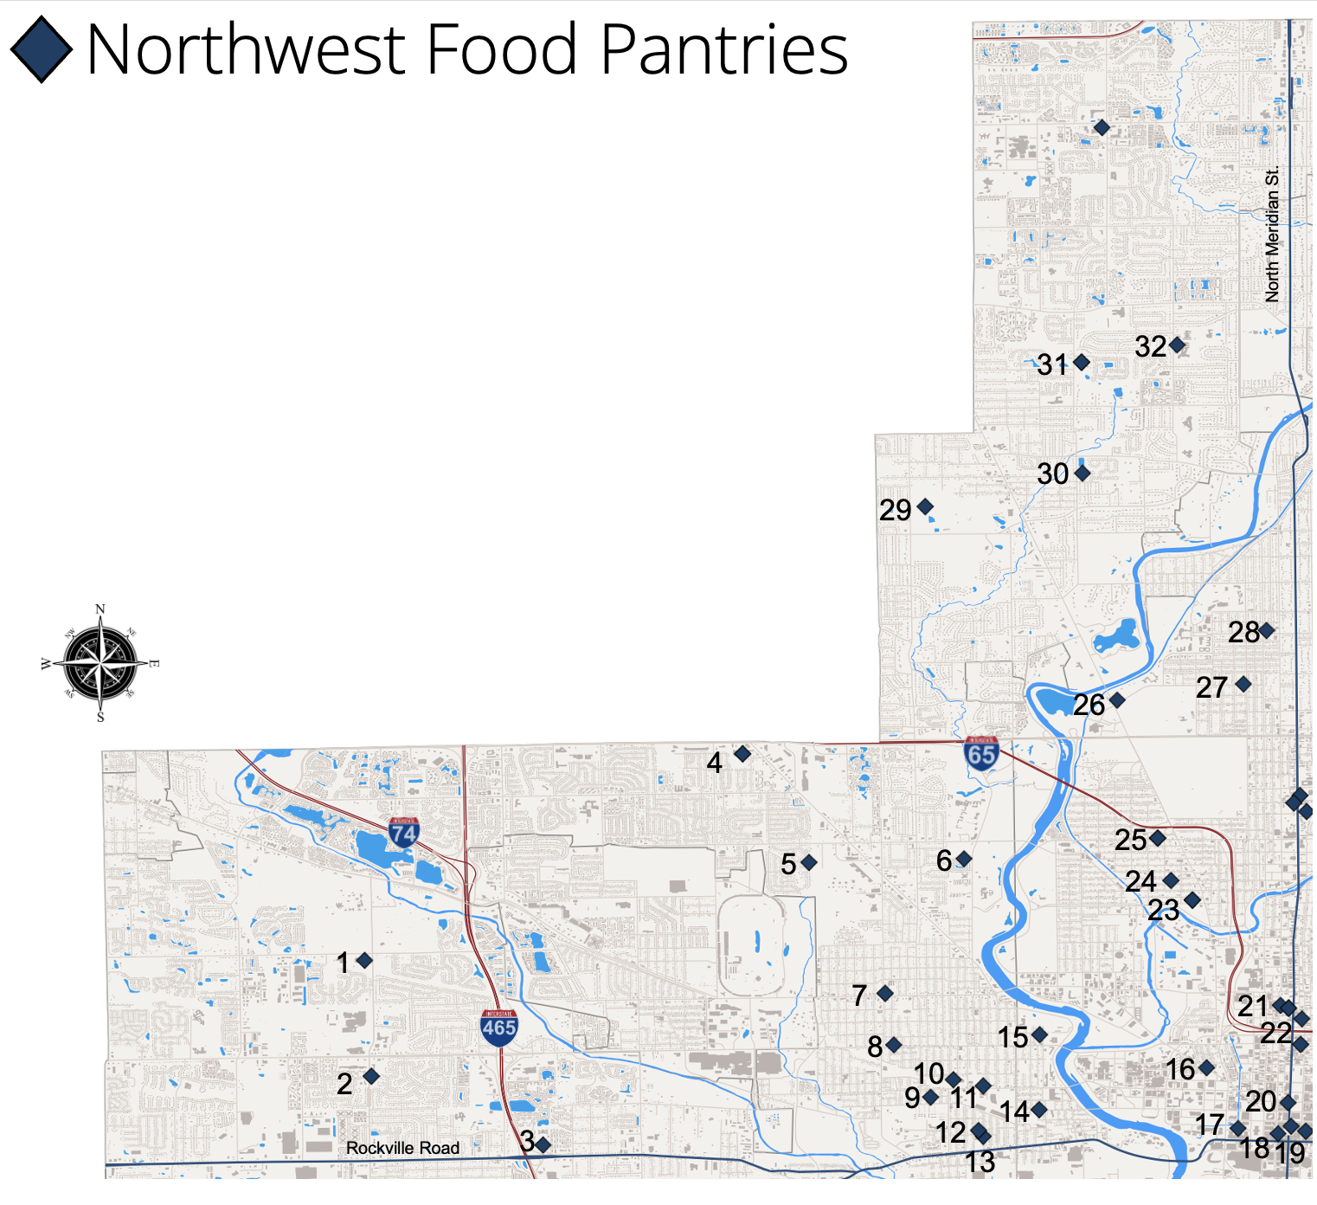

Service Coordination 2a
Name | Address | Phone Number | Hours | Eligibility Criteria | Key Details i.e. languages offered
9| Amazing Grace | 440 Ketcham St | (317) 955-2581 | Friday night 6-8:30 PM |  | daltonsfoodpantry@gmail.com
25 | Barnes United Methodist Church | 900 W 30th St | (317) 923-9197 | 3rd Thursdays 6-7:30 PM
27 | Boulevard Place Food Pantry | 4202 Boulevard Pl | (317) 924-3461 | Wednesday: 10a-12p, Thursday: 10a-4p, Saturday: 9a-12p | One visit per calendar week | https://www.svdpindy.org/category/boulevard-place-food-pantry/
22 | Catholic Charities Indianapolis - Food Distribution Center | 1400 N Meridian St | (317) 236-1556 |  |  | https://www.helpcreatehope.org/
21 | Catholic Charities Indianapolis Food Pantry | 1435 N Illinois St | (317) 236-1512 | Monday 1p-3p and 5p-6p Tuesday through Thursday 10a- 11a and 1p-3p
https://helpcreatehope.org/crisis-office

Slide 3
Paste Map Here
Name | Address | Phone Number | Hours | Eligibility Criteria | Key Details i.e. languages offered

